Slide 1
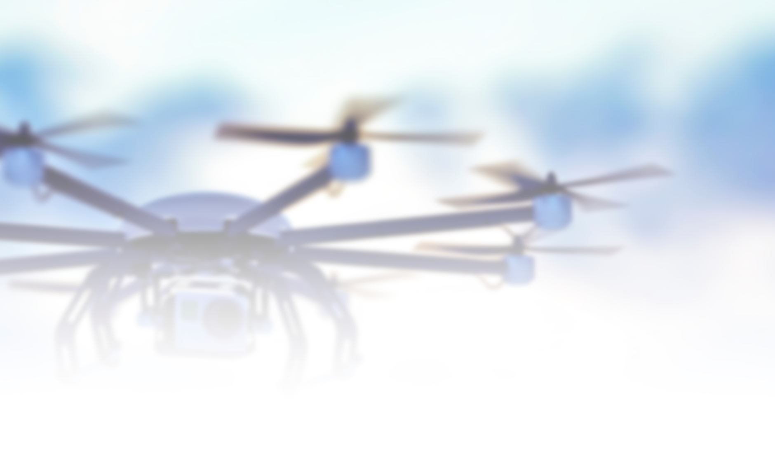

A29 – STEM Outreach – UAS as a STEM Outreach Learning Platform for K-12 Students and Educators (STEM III)
Lesson 1 Programming the Tello with DroneBlocks

Slide 2

What are is an UAV or Drone
An unmanned aerial vehicle UAV, commonly known as a drone, is an aircraft without any human pilot, crew, or on-board passengers.
The first drone was developed in 1935 to be used as aerial target practice
The drone market was worth 6.51 Billion in 2021 and is projected to rise to 47.38 in 2029 (Fortune)
Drones are being used more than ever in a wide range of fields ranging from agriculture to weather forecasting

Slide 3
Research Project
The drone market is fast growing, and you want to get in on that action!
Take a good look at how drones could be used to the commercial sector to solve modern problems
Each group needs to submit what they will be talking about to the teacher so that no two groups are working on the same idea
Groups should explain why they chose their problem to solve, how drones can help solve this problem, and if the technology exist already or does it need to be developed

Slide 4
Proper Drone Safety and Regulations
Part 107 is the Federal Aviation Administration FAA rule for operating small Unmanned Aircraft Systems sUAS
Having a part 107 allows a person to commercially fly drones
All drones weighing over .55 need to be registered with the FAA

Slide 5
What is the Tello EDU Drone
The Tello EDU is an indoor mini drone quadcopter that is useful for beginners as well as teaching various programming languages
Hardware specs of the Tello are weight 87g, 3-inch propeller, range finder, barometer, led, vision system, and Wi-Fi
Flight performance specs of the Tello are it has a maximum distance of 100m, a max speed of 8 m/s, a max flight time of 13 minutes and max ceiling height of 30 meters

Slide 6
What is DroneBlocks
DroneBlocks is a drag and drop block programming environment that supports many of the leading DJI drones
Using DroneBlocks students will be writing progressively more complex code

Slide 7
How to Connect a Device to the Tello
Each Tello creates its own unique Wi-Fi network when it is powered on. Inside the drone’s battery slot on the bottom there is a small sign has the Wi-Fi network name for that specific Tello.
Once the Tello is powered on it will blink different colors for about 15 seconds before flashing yellow indicating it is ready to pair. Then a device with Wi-Fi capabilities can be connected to the drone.
Now that the Tello is connect the device can send scripts for the drone to preform.

Slide 8
Assignment
Follow along with the DroneBlock “Introduction to Tello Drone Programming” and “Advanced Tello Programming with DroneBlocks” tutorials to learn how to control the Tello using code
https://learn.droneblocks.io/p/introduction-to-tello-edu-drone-programming-with-droneblocks

Slide 9
Citation
Fortune Business Insights, “Commercial drone market worth USD 47.38 billion by 2029: Increasing demand for small drones in commercial applications to propel market growth: Fortune Business Insights™,” GlobeNewswire News Room, 24-May-2022. [Online]. Available: https://www.globenewswire.com/news-release/2022/05/24/2448921/0/en/Commercial-Drone-Market-Worth-USD-47-38-Billion-by-2029-Increasing-Demand-for-Small-Drones-in-Commercial-Applications-to-Propel-Market-Growth-Fortune-Business-Insights.html. [Accessed: 18-Jul-2022].

